Slide 1
SmartArt - Lists

Slide 2
SmartArt - Lists

Slide 3
SmartArt - Lists

Slide 4
SmartArt - Lists

Slide 5
SmartArt - Lists

Slide 6
SmartArt - Lists

Slide 7
SmartArt - Lists

Slide 8
SmartArt - Lists

Slide 9
SmartArt - Lists

Slide 10
SmartArt - Lists

Slide 11
SmartArt - Lists

Slide 12
SmartArt - Lists

Slide 13
SmartArt - Lists

Slide 14
SmartArt - Lists

Slide 15
SmartArt - Lists

Slide 16
SmartArt - Lists

Slide 17
SmartArt - Lists

Slide 18
SmartArt - Lists

Slide 19
SmartArt - Lists

Slide 20
SmartArt - Lists

Slide 21
SmartArt - Lists

Slide 22
SmartArt - Lists

Slide 23
SmartArt - Lists

Slide 24
SmartArt - Lists

Slide 25
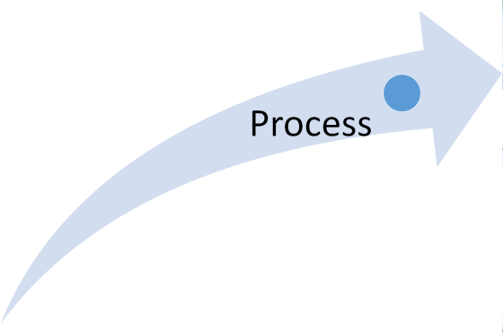
SmartArt - Process

Slide 26
SmartArt - Process

Slide 27
SmartArt - Process

Slide 28
SmartArt - Process

Slide 29
SmartArt - Process

Slide 30
SmartArt - Process

Slide 31
SmartArt - Process

Slide 32
SmartArt - Process

Slide 33
SmartArt - Process

Slide 34
SmartArt - Process

Slide 35
SmartArt - Process

Slide 36
SmartArt - Process

Slide 37
SmartArt - Process

Slide 38
SmartArt - Process

Slide 39
SmartArt - Process

Slide 40
SmartArt - Process

Slide 41
SmartArt - Process

Slide 42
SmartArt - Process

Slide 43
SmartArt - Process

Slide 44
SmartArt - Process

Slide 45
SmartArt - Process

Slide 46
SmartArt - Process

Slide 47
SmartArt - Process

Slide 48
SmartArt - Process

Slide 49
SmartArt - Process

Slide 50
SmartArt - Process

Slide 51
SmartArt - Process

Slide 52
SmartArt - Process

Slide 53
SmartArt - Process

Slide 54
SmartArt - Process

Slide 55
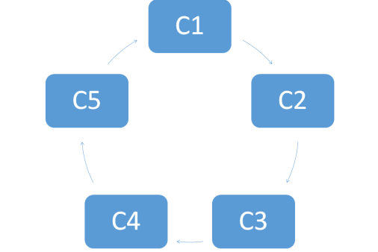
SmartArt - Cycle

Slide 56
SmartArt - Cycle

Slide 57
SmartArt - Cycle

Slide 58
SmartArt - Cycle

Slide 59
SmartArt - Cycle

Slide 60
SmartArt - Cycle

Slide 61
SmartArt - Cycle

Slide 62
SmartArt - Cycle

Slide 63
SmartArt - Cycle

Slide 64
SmartArt - Cycle

Slide 65
SmartArt - Cycle

Slide 66
SmartArt - Cycle

Slide 67
SmartArt - Cycle

Slide 68
SmartArt - Cycle

Slide 69
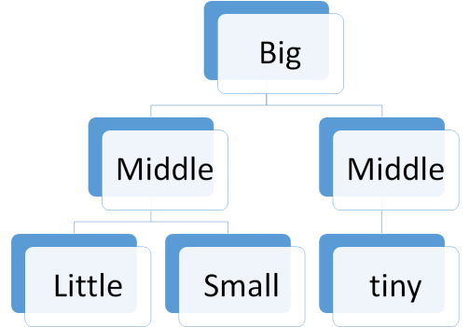
SmartArt - Hierarchy

Slide 70
SmartArt - Hierarchy

Slide 71
SmartArt - Hierarchy

Slide 72
SmartArt - Hierarchy

Slide 73
SmartArt - Hierarchy

Slide 74
SmartArt - Hierarchy

Slide 75
SmartArt - Hierarchy

Slide 76
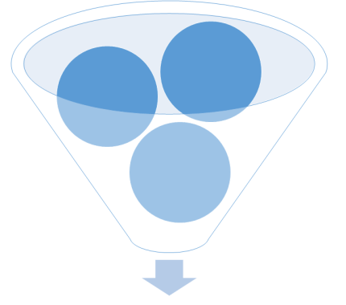
SmartArt - Relationship

Slide 77
SmartArt - Relationship

Slide 78
SmartArt - Relationship

Slide 79
SmartArt - Relationship

Slide 80
SmartArt - Relationship

Slide 81
SmartArt - Relationship

Slide 82
SmartArt - Relationship

Slide 83
SmartArt - Relationship

Slide 84
SmartArt - Relationship

Slide 85
SmartArt - Relationship

Slide 86
SmartArt - Relationship

Slide 87
SmartArt - Relationship

Slide 88
SmartArt - Relationship

Slide 89
SmartArt - Relationship

Slide 90
SmartArt - Relationship

Slide 91
SmartArt - Relationship

Slide 92
SmartArt - Relationship

Slide 93
SmartArt - Relationship

Slide 94
SmartArt - Relationship

Slide 95
SmartArt - Relationship

Slide 96
SmartArt - Relationship

Slide 97
SmartArt - Relationship

Slide 98
SmartArt - Relationship

Slide 99
SmartArt - Relationship

Slide 100
SmartArt - Relationship

Slide 101
SmartArt - Relationship

Slide 102
SmartArt - Relationship

Slide 103
SmartArt - Relationship

Slide 104
SmartArt - Relationship

Slide 105
SmartArt - Relationship

Slide 106
SmartArt - Relationship

Slide 107
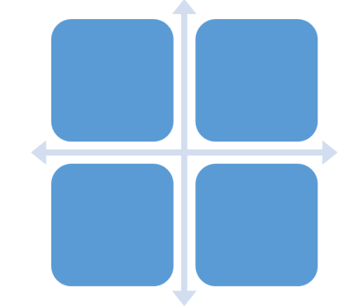
SmartArt - Matrix

Slide 108
SmartArt - Matrix

Slide 109
SmartArt - Matrix

Slide 110
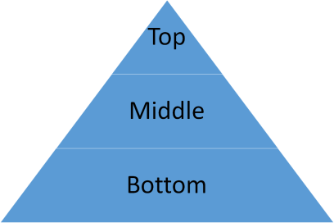
SmartArt - Pyramid

Slide 111
SmartArt - Pyramid

Slide 112
SmartArt - Pyramid

Slide 113
SmartArt - Pyramid

