Slide 1
Introduction to Chemistry
Physical Science topic 14

Slide 2
About Atoms
Atoms are the basic unit of a chemical element.
An atom a fundamental piece of matter. (Matter is anything that can be touched physically.)
Everything in the universe (except energy) is made of matter, and, so, everything in the universe is made of atoms.

Slide 3
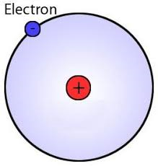
H
Hydrogen

Slide 4
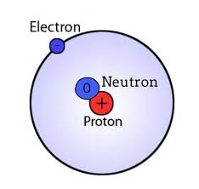
H
Hydrogen

Slide 5
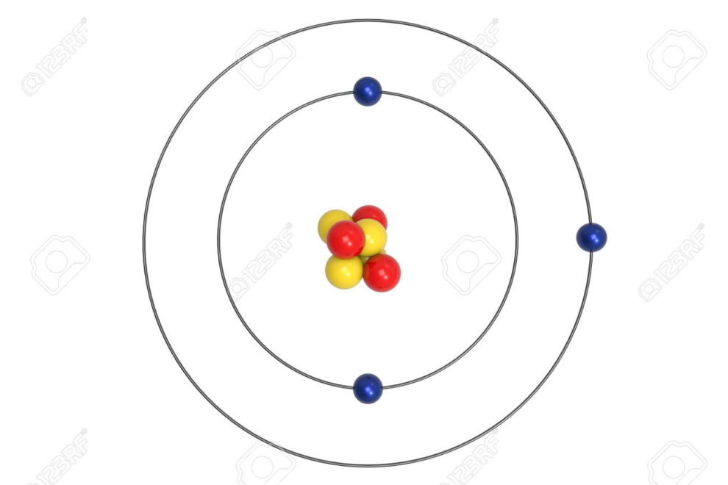
Li
Lithium

Slide 6
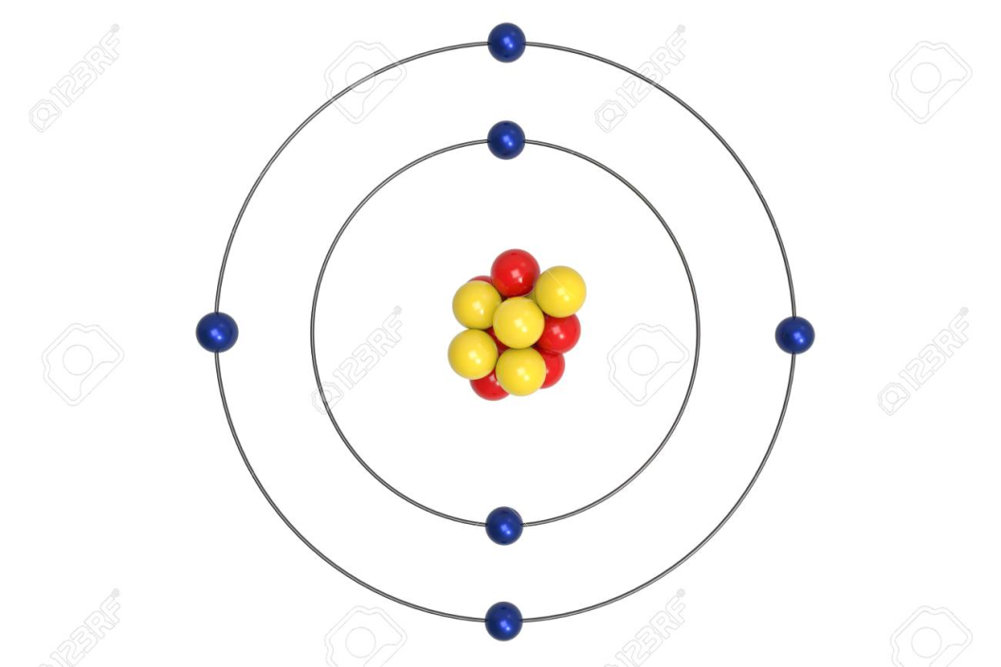
C
Carbon

